Slide 1
Advanced AB testing in practice
By: Eltsefon Mark

Slide 2

Novelty. Exercise
Our product is a mobile game
We want to change our third level
Our metric is average revenue per user

Slide 3
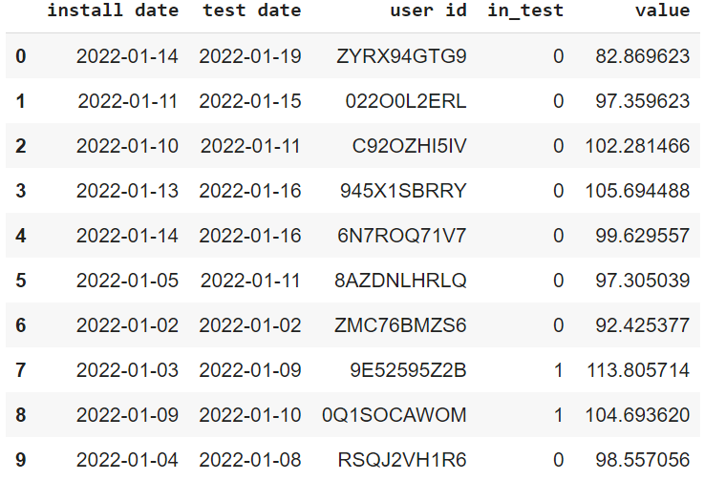
Novelty. Data

Slide 4
Novelty. Possible solutions
Our new design is better
Our new design is worse
We should prolong our test

